Slide 1

Mini Project-II (ID201B) Even Semester Session 2024-25
E-Commerce Website
MONTY SHARMA (2426MCA1965)
MANISH KUMAR (2426MCA669)
MOHD KASIF KHAN (2426MCA1946)
MOHD FAIJAN(2426MCA2585)
Project Supervisor:
Supervisor Name-.Shruti Aggarwal
Designation- Assistant Professor

Slide 2
Contents
S.No | Topics
1. | Introduction
2. | Objectives of the project
3. | Literature Review
4. | Technology requirements
5. | User Interface of Electro Bazaar
6. | Reports
7. | References
Notes:
Font Styles: Times New Roman + Font Size: 25

Slide 3
Introduction
Welcome to ElectroBazaar, your ultimate destination for cutting-edge electronics.
Our website offers a comprehensive platform for tech enthusiasts of all levels.
Explore a wide range of high-quality electronics, from smartphones to smart gadgets.
Stay updated with the latest technology and innovative products.
Suitable for both casual buyers and tech-savvy professionals.
User-friendly interface ensures easy navigation and a seamless shopping journey.
Getting the latest technology has never been easier.
Notes:
Font Styles: Times New Roman + Font Size: 25

Slide 4
Objective of the Project
Easy Access to Latest Tech – Provide a smooth and hassle-free shopping experience for everyone.
Personalized Suggestions – Recommend the best products based on customer needs.
Smart & Informed Shopping – Help users make the right choices with clear product details and reviews.
Better User Experience – Build a friendly online space for tech lovers to connect and learn.
Secure & Fast Shopping – Ensure safe payments and quick delivery for a hassle-free experience.
Notes:
Font Styles: Times New Roman + Font Size: 25

Slide 5
Literature Review
Growth of E-Commerce – More people prefer buying electronics online due to better deals
and convenience.
Effectiveness of Online Shopping – Online stores save time and offer a wider range of
products than physical shops.
Importance of Customer Support – Quick assistance through chat support and helplines
improves the shopping experience.
Role of Discounts and Offers – Special deals and seasonal discounts attract more buyers and boost sales.
Secure Payments & Fast Delivery – Safe transactions and quick delivery build trust and customer loyalty.
Notes:
Font Styles: Times New Roman + Font Size: 25

Slide 6
Technology (Hardware & Software Requirements)
Hardware Requirements
Processor: Minimum 2 GHz dual-core or higher for efficient server-side processing.
RAM: 4 GB or more to ensure smooth execution of web pages and database operations.
Storage: 500 GB HDD/SSD (preferably SSD) for storing system data and ensuring fast performance.
Software Requirements
Frontend: HTML, CSS, JavaScript for responsive design and interactivity.
Backend: SpringBoot, SpringJWT for better experience and security purpose.
Database: MySQL for efficient data management.
Notes:
Font Styles: Times New Roman + Font Size: 25

Slide 7
Modules
1. HOME
2. LOGIN
3. REGISTRATION, PROFILE
4. ADD PRODUCT , ADD CATEGORY, VIEW PRODUCT, ADD ORDERS
5. USERS, ADD ADMIN
6. VIEW ADMIN
7. CART PAGE
Notes:
Font Styles: Times New Roman + Font Size: 25

Slide 8
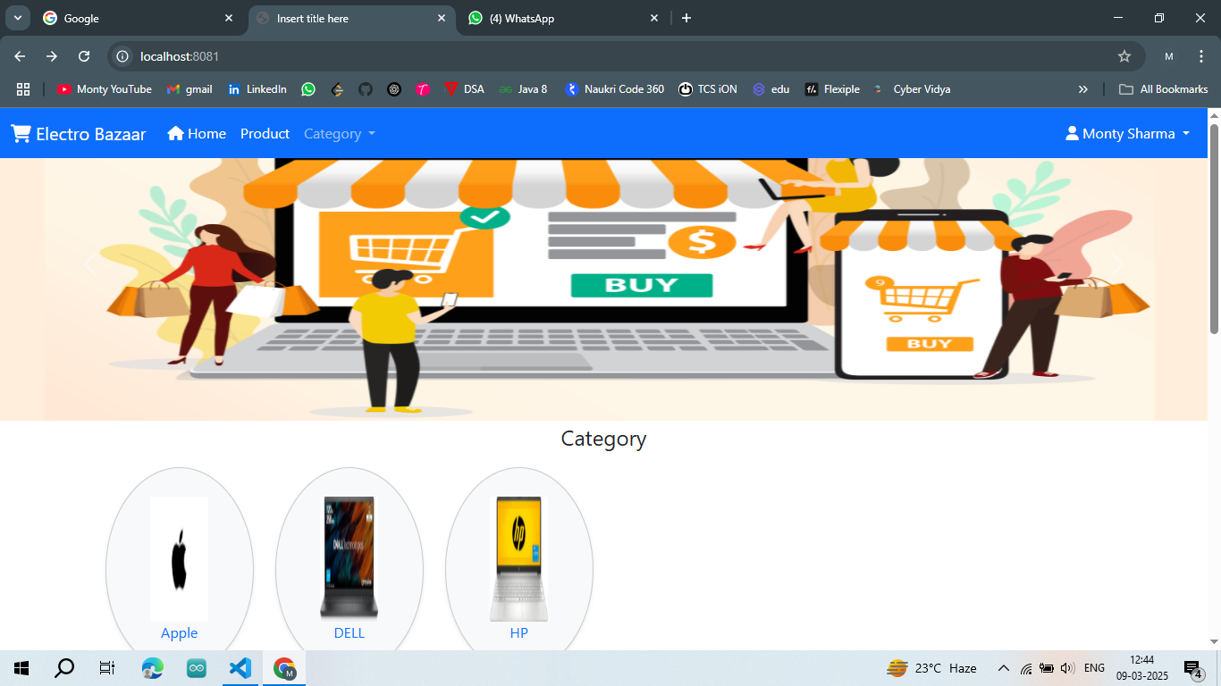
User Interface of Electro Bazaar
HOME PAGE
Notes:
Font Styles: Times New Roman + Font Size: 25

Slide 9
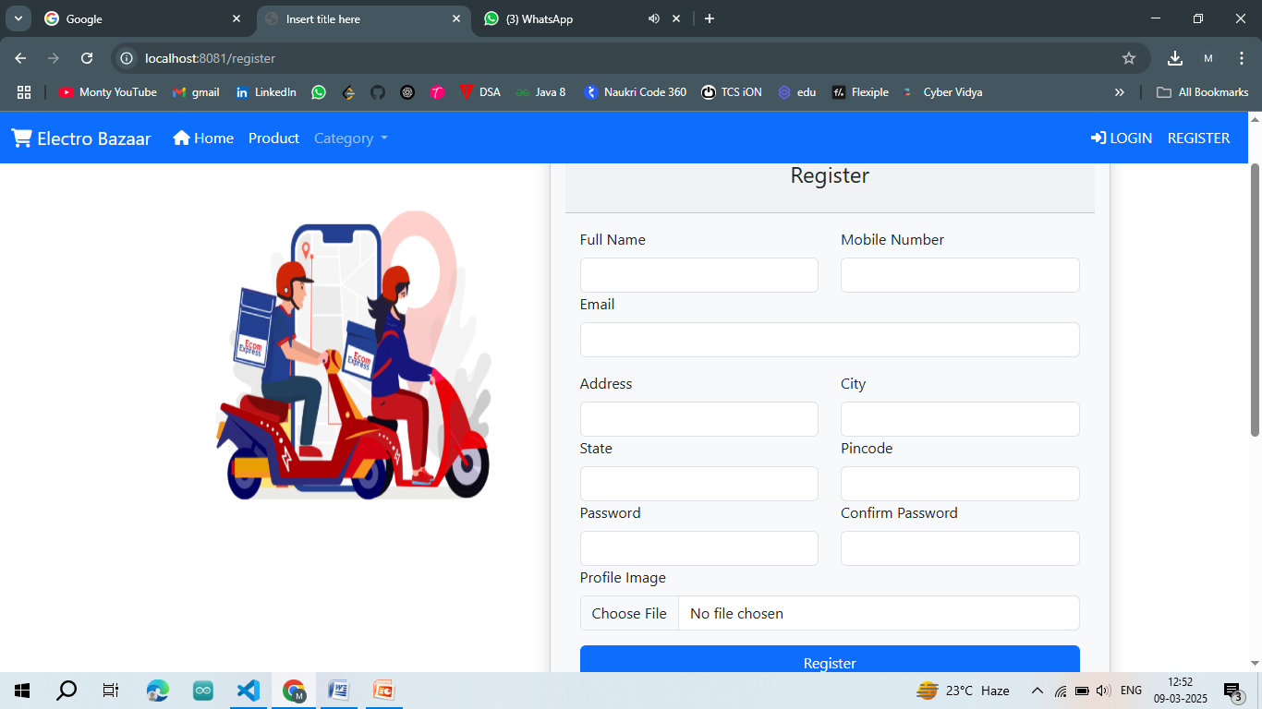
REGISTRATION PAGE

Slide 10
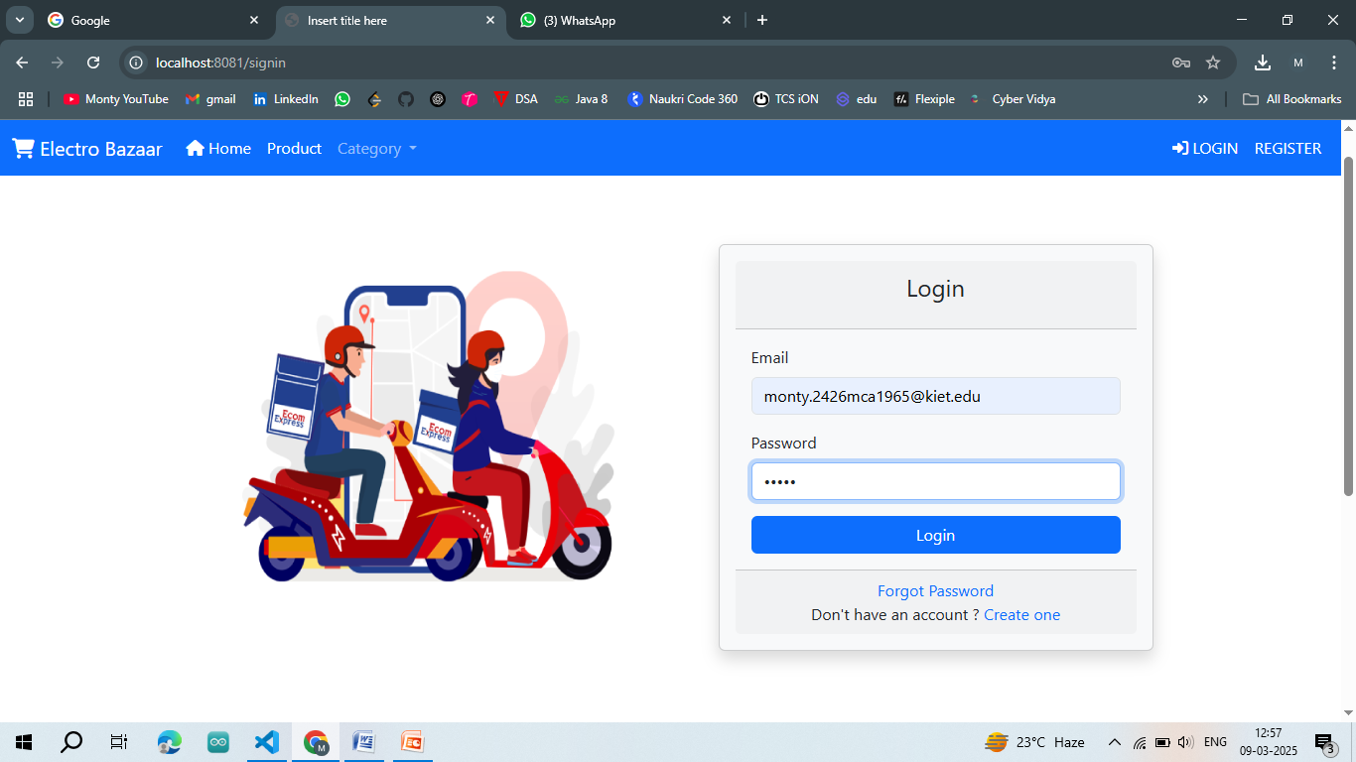
LOGIN PAGE

Slide 11
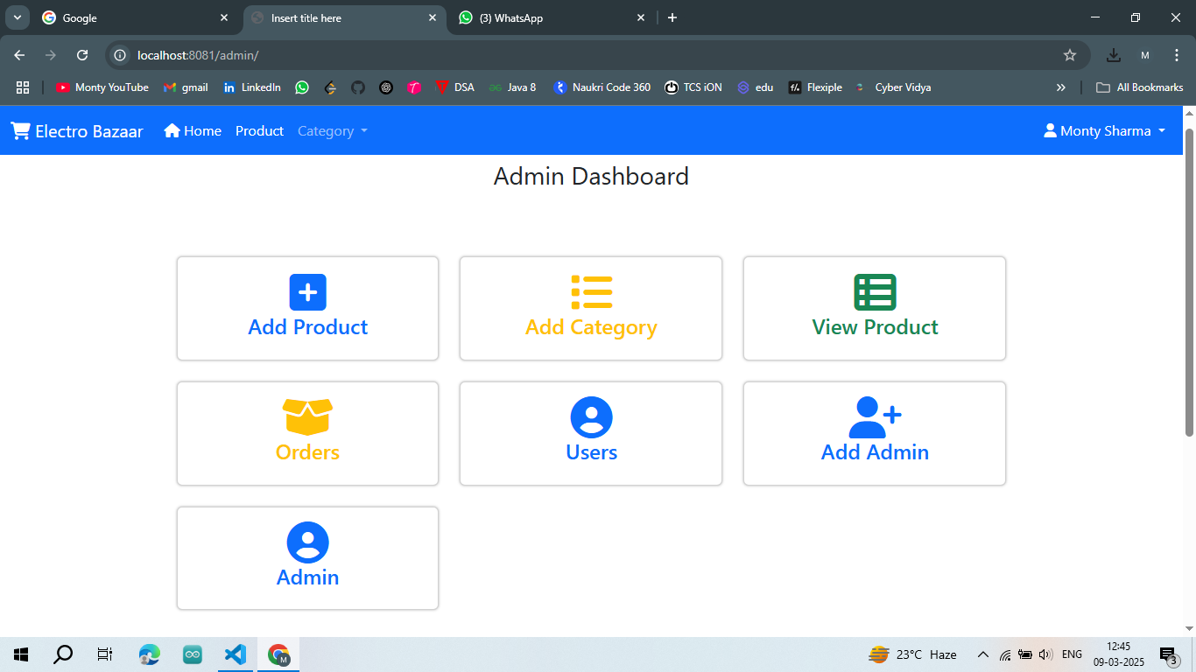
ADMIN DASHBOARD

Slide 12
Reports
1. Home Page
Purpose: Overview of the platform and featured products. Features: Product categories, search bar, promotional banners.
2. Login Page
Purpose: Secure user authentication. Features: Email/password login, password recovery.
3. Registration & Profile
Purpose: User account creation and management. Features: Registration form, profile update, password reset.
4. Product Management
Purpose: Admin product catalog management. Features: Add/view products, manage stock.
5. Order Management
Purpose: Order tracking and processing. Features: Order placement, status updates.
6. User & Admin Management
Purpose: Manage users and admin roles. Features: View users, add admins, assign roles.
7. Cart Page
Purpose: Manage selected items before purchase. Features: View/update cart, checkout process.
Notes:
Font Styles: Times New Roman + Font Size: 25

Slide 13
References
Spring Framework(Spring.io) – Official Spring Framework documentation and tools.
Spring Boot Documentation Spring Boot simplifies the development of stand-alone, production-grade Spring-based applications.
Spring Initializr Tool for generating Spring Boot project structure.
Spring Data JPA Used for handling database operations in your backend.
Notes:
Font Styles: Times New Roman + Font Size: 25

